Slide 1
WEB Fundamentals

Slide 2
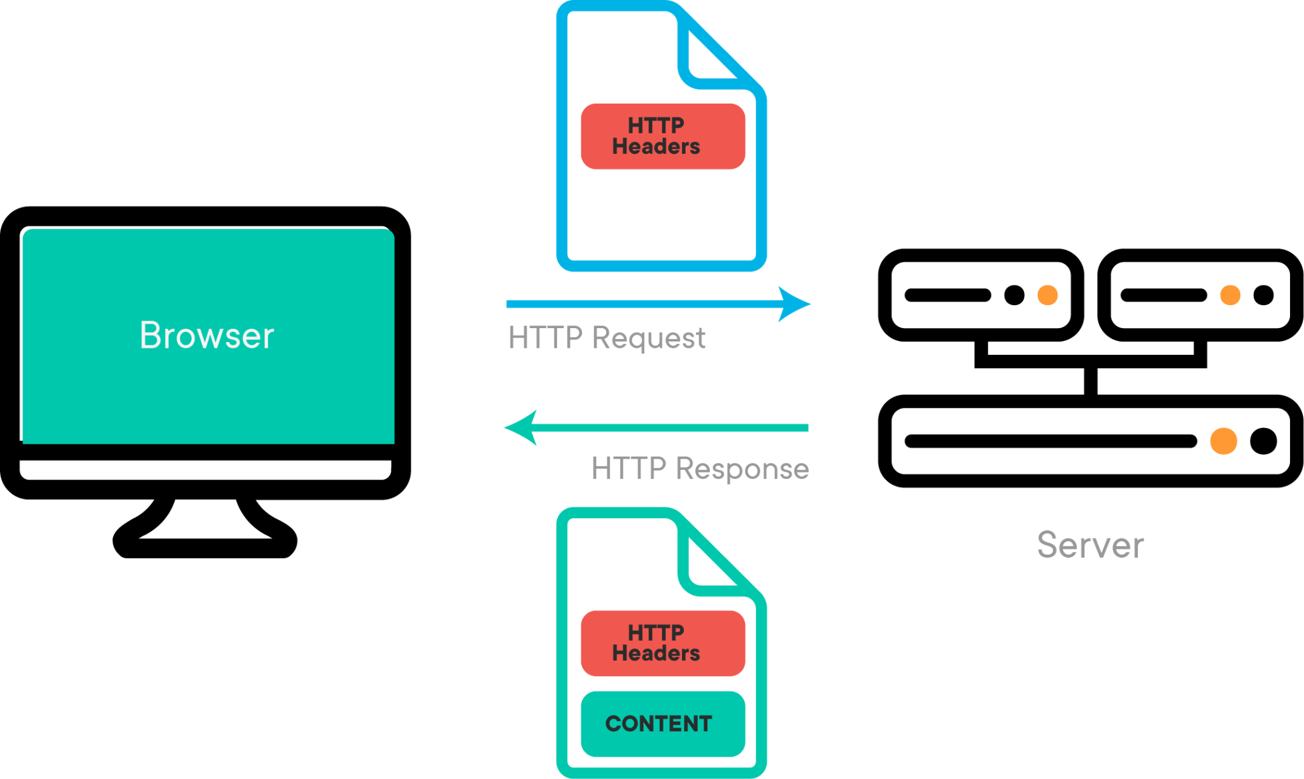
How the WEB works
Clients and servers
Computers connected to the web are called clients and servers. A simplified diagram of how they interact might look like this:
Clients are the typical web user's internet-connected devices (for example, your computer connected to your Wi-Fi) and web-accessing software available on those devices (usually a web browser like Firefox or Chrome).
Servers are computers that store webpages, sites, or apps. When a client device wants to access a webpage, a copy of the webpage is downloaded from the server onto the client machine to be displayed in the user's web browser.

Slide 3
WEB Developer tools
A computer : Obviously
A text editor : to write code in such as Visual Studio Code, sublime text, vim, notepad+++ ...
Web Browser : to test code in. Currently, the most-used browsers are : Chrome, Firefox …
A graphics editor : to make images or graphics for your web pages : Photoshop, GIMP, XD …
A version control system : to manage files on servers, collaborate on a project with a team, share code and assets and avoid editing conflicts : GitHub

Slide 4
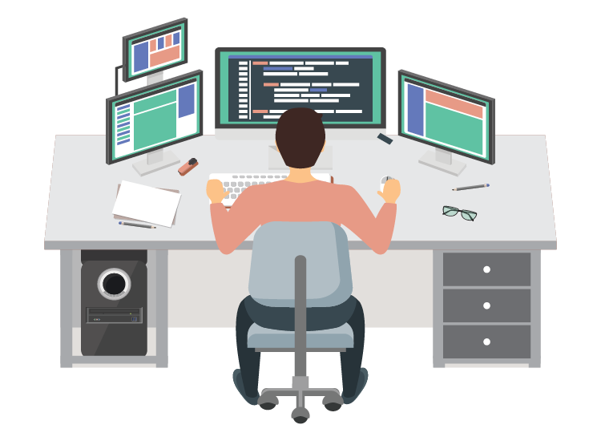
Web Developer roles and duties
What is web development?
A web developer’s job is to create websites. While their primary role is to ensure the website is visually appealing and easy to navigate, many web developers are also responsible for the website’s performance and capacity.
Types of Web Developers :
Front-End web developer : work on the visual part of the website, the pages visitors see and interact with. They design the physical layout of each page, integrate graphics, and use HTML and JavaScript to enhance the site.
Back-End web developer : create the website’s structure, write code, and verify the code works.
Full-Stack Developer : do the work of both a back-end and front-end developer
WebMasters : are essentially website managers. Their primary responsibility is to keep the website updated

